Slide 1




Assessing the Usability of Tor Browser as a Censorship Circumvention Tool
Linda Lee, David Fifield, Nathan Malkin
with Serge Egelman, David Wagner

Slide 2



Notes:
Usability, usability study on tor, usability study on tor for censorship circumvention.
This is the first large-scale user study of Tor for censorship circumvention.

Slide 3
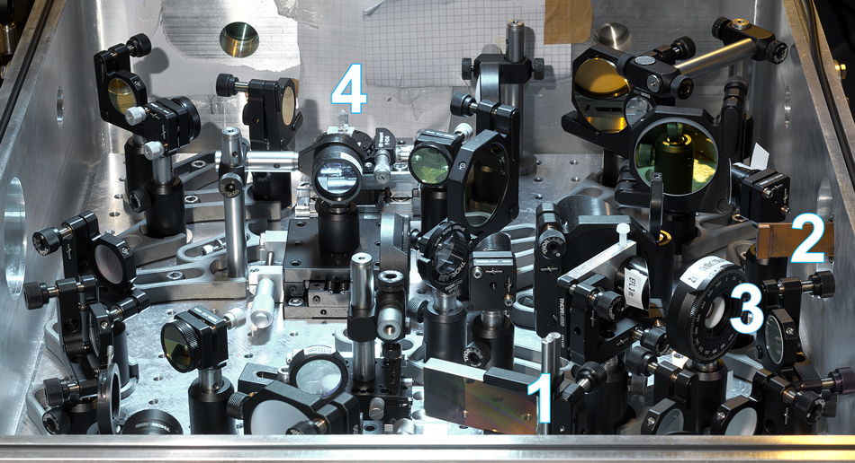
Notes:
START OF USABILITY? EE background, Paris REU, high-powered femtosecond pulsed 4-pass grating laser, non-linear optics, communications, government/military communications technology.
Thinking about interfacing with users, leveraging their understanding, building mental models, making assumptions about what they know. Easy, because mom, not so easy for general pop.

Slide 4
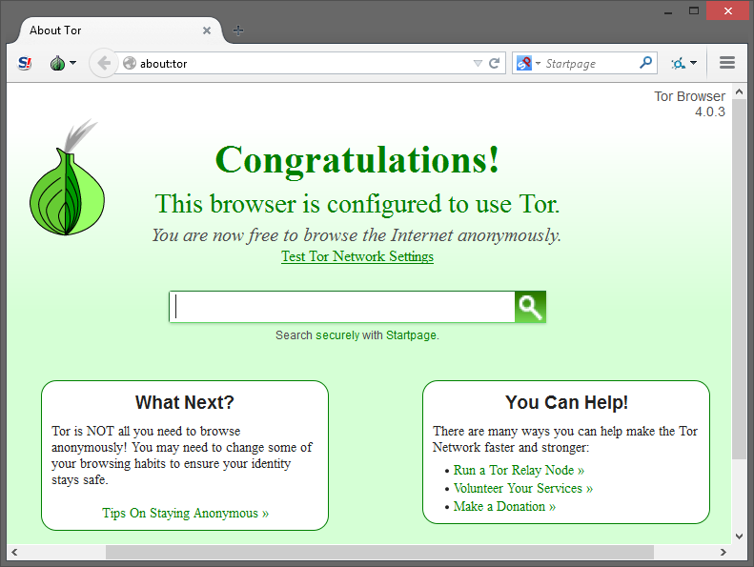
Notes:
WHY TOR BROWSER? Already deployed, millions of users, current sophistication to censorship technologies.

Slide 5
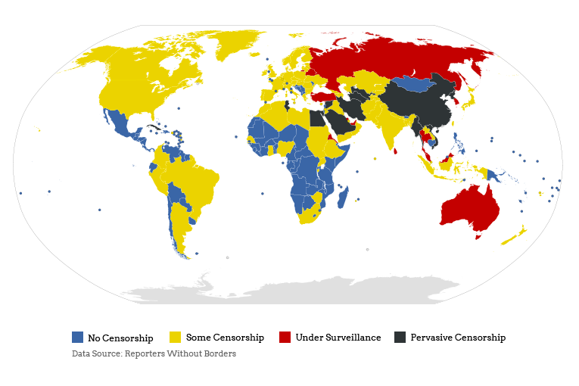
Notes:
WHY CENSORSHIP? Censorship is pervasive. Internet freedom is key to knowledge. I love to learn. Also ethical motivations on top of intellectually stimulating.

Slide 6
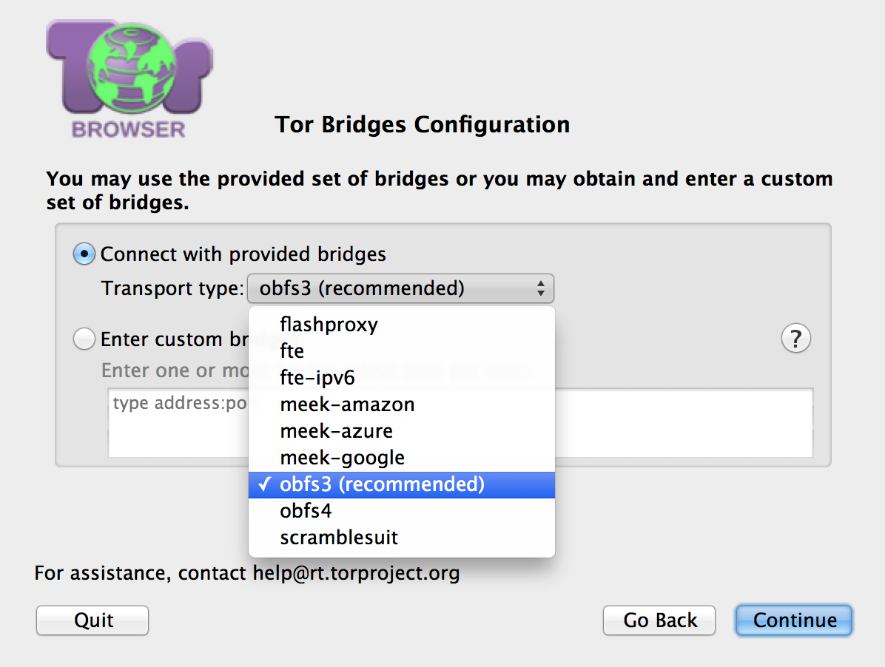
Notes:
WHY CONFIG INTERFACE? First to eval usability of Tor as censorship circumvention tool. Independent of how tor browser works, easily deployable, developer support, need for evaluation.
PURPOSE: BRIDGE AND PROXY. THERE ARE 5 paths through this dialogue.
5 WINDOWS, walk through them. Narrate defaults, assumptions, and what we require of users.

Slide 7
Current Assumptions
Most users will not need to configure their network for a bridge or proxy.
Users do not know the difference between a bridge and proxy.
Users will correctly be able to choose a pluggable transport which will work.

Slide 8
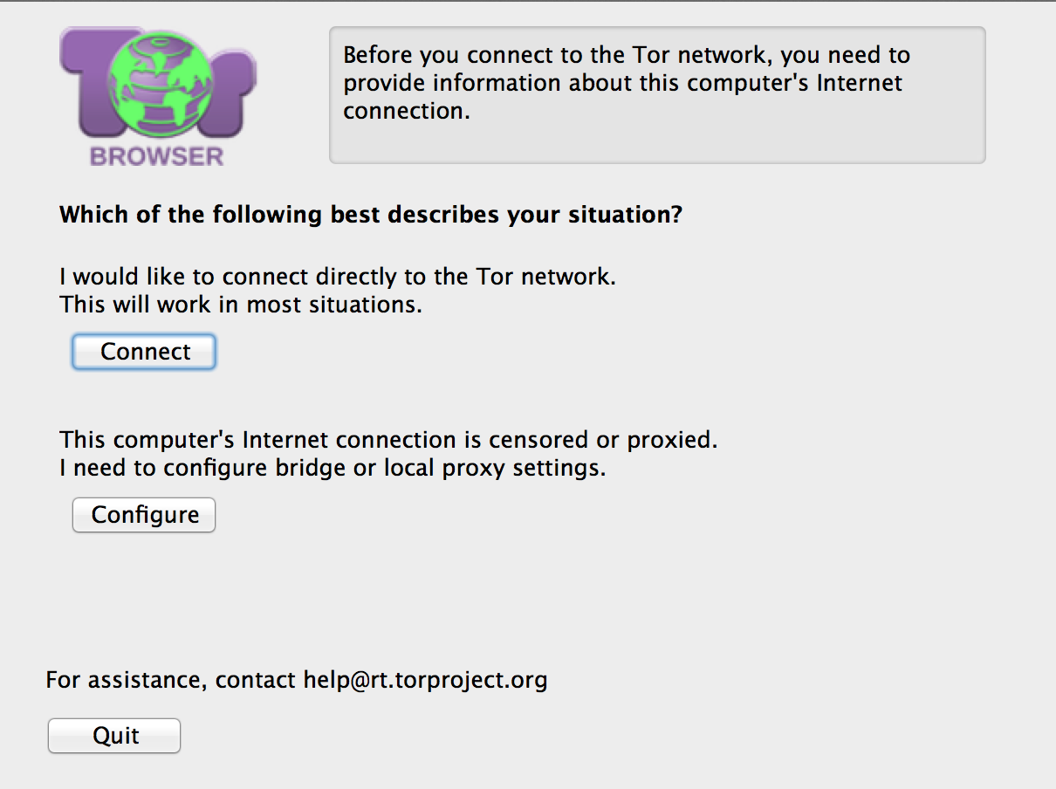

Slide 9
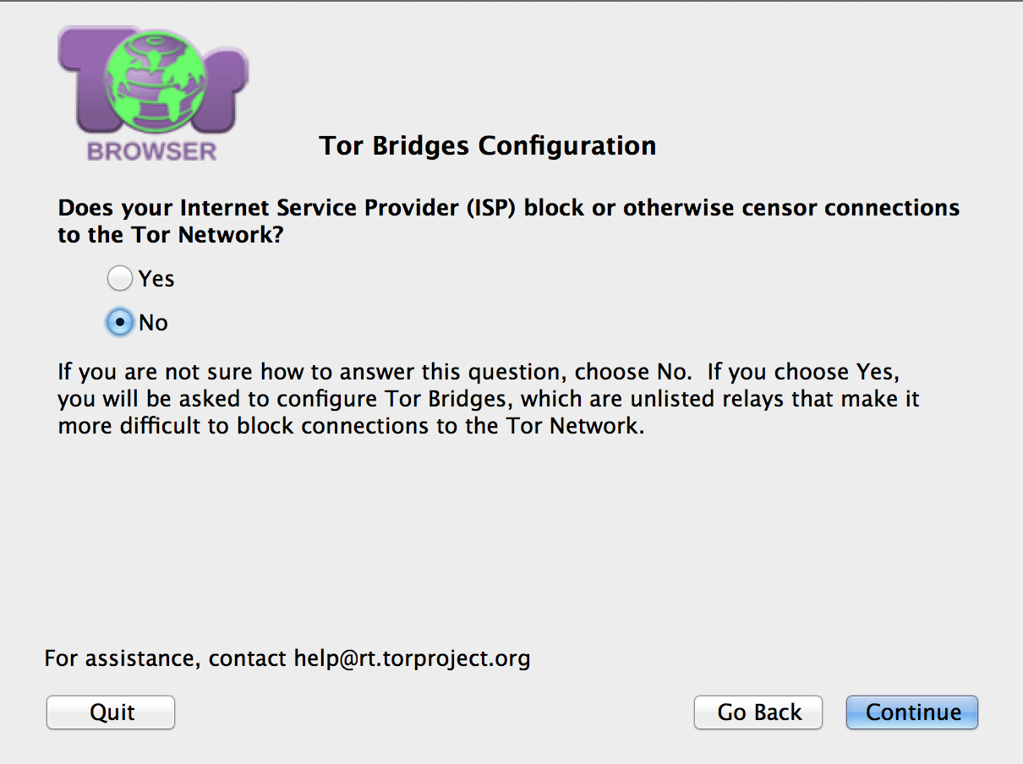

Slide 10
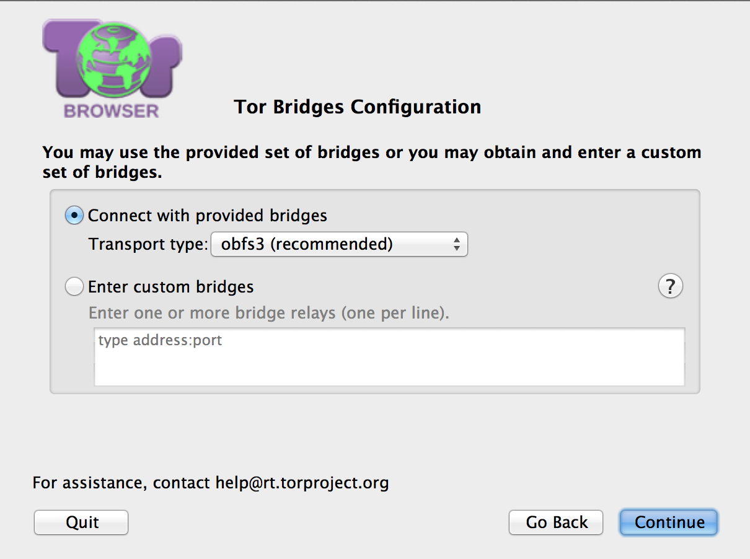

Slide 12
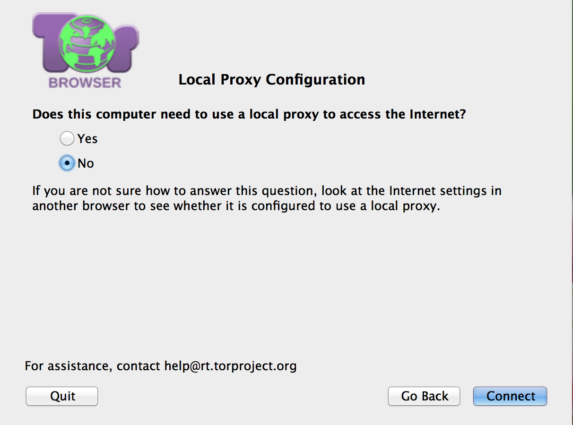

Slide 13
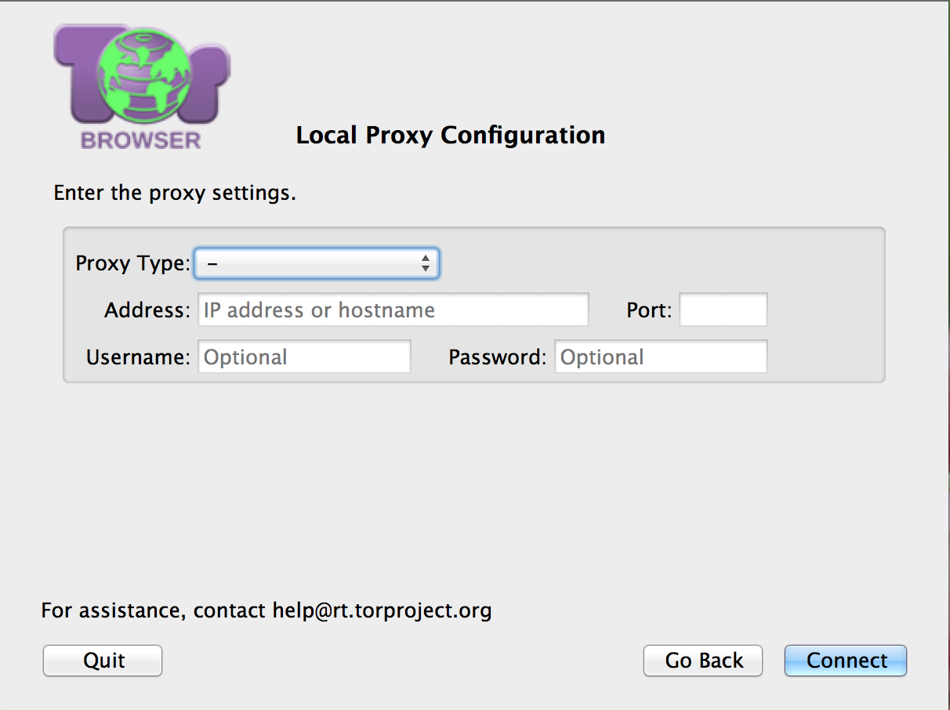

Slide 14
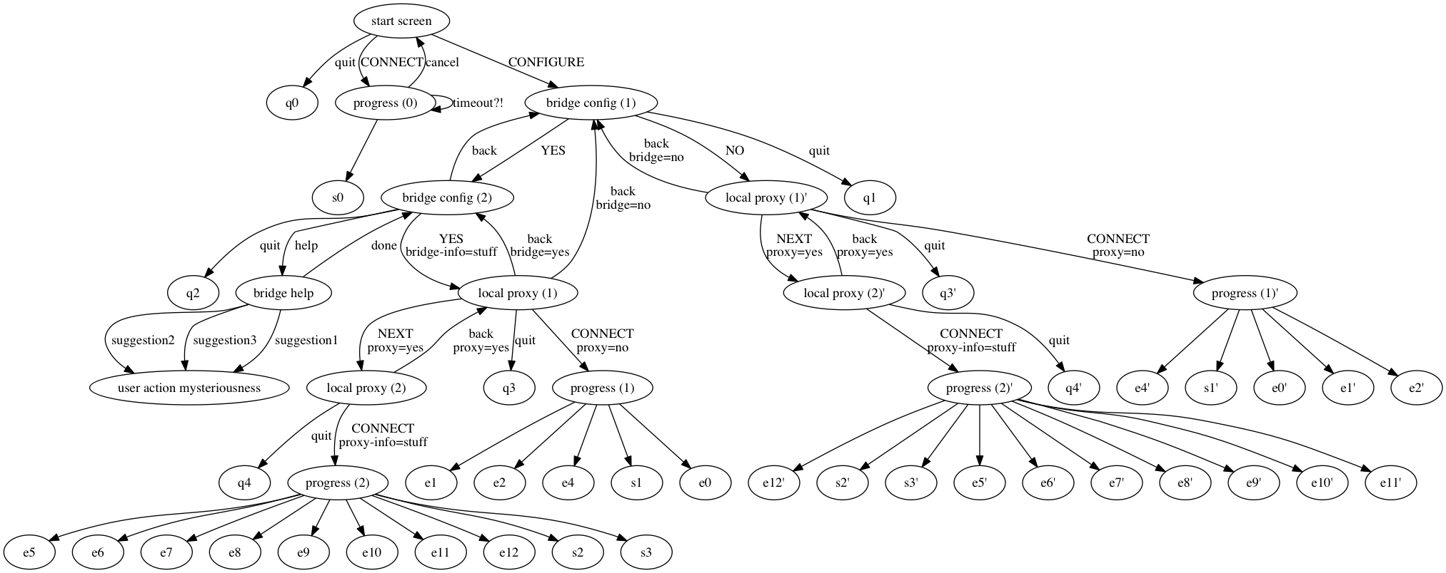
Notes:
Enumerated all paths, will model paths, time paths. Prune trees, reduce transitions, end states.
Error states: correct bridge, wrong proxy config // wrong bridge, right proxy config // default port is bad, ip addesses syntax/validity..

Slide 15
Hypotheses
People don’t know the difference between a bridge and proxy
People will confuse bridges and proxies
People will try transports randomly or pick ones that sounds familiar
People won’t enter custom bridges, won’t click on “?”
Minor dialogue optimizations can be made

Slide 16
Experiment Overview
“normal” population, Xlab, windows machines, fall 2015
Quantitative measurements: paths taken, time taken, task completion
Qualitative measurements: demographics, technical, tor familiarity, feedback questions

Slide 17
Experiment Goals
Measure usability of the configuration interface currently
Validate Tor’s current assumptions about the user
Test our hypotheses
Test improvements to interface
Test an alternate interface
Deploy changes

Slide 18
Getting Other Interfaces
Interface improvements: based on results of current interface, combination of usability and design
Alternate interface: collaboration with Tor developers

Slide 19
Experiment Flow
3 sets of experiments: current, improvement, and alternate interface
Participant briefing
Explanation of Tor
Completing tasks
Exit Survey
Debriefing

Slide 20
We have placed you in a network in which some websites are blocked. In your favorite web browser, please go to <non-blocked website> to confirm that the Internet is working. Now, go to <blocked website> to confirm that some websites are blocked. If a website does not load for you, it is because the website is blocked, not because the website is having technical issues.
We put you in this restricted network so that we can test Tor Browser, a web browser that, when properly configured, can circumvent censorship and access blocked websites. There is no single correct configuration; many different configurations may work to circumvent censorship. You have successfully circumvented censorship when you complete all the tasks on your worksheet.

Slide 21



Censorship environments
Mild censorship
Intermediate censorship
Comprehensive censorship
Notes:
Mild: france/australia (tor), inter: Tunsia (tor, any bridge), comprehensive: china/syria (tor, some bridges)
Images, ip addresses from onionoo blockes all bridges, blocked hardcoded bridges, block hostnames.
Inidvidual host firewalls

Slide 22

Internet-based Tasks
Google search for the population of Zimbabwe.
Find the Amazon best-sellers in “Movies & TV.”
On Twitter, find the currently trending topics.
On Bing Maps, find directions from Times Square to Carnegie Hall.
Notes:
Indication of success, same for all censorship environments, not intended to be hard, some will be blocked, some will not be blocked.

Slide 23
Exit Survey
Identifiers (2) session id, participant id
Demographics (3) gender, age, education
Participant background (4) technical knowledge, Tor familiarity, security practices, how users ask for help
Testing hypotheses (8) bridge and proxy definition, bridge choice, confidence in configuration, confidence in Tor’s security guarantees
Experiment follow-up (4) improvements, confusions, unexpected events, use again?

Slide 24
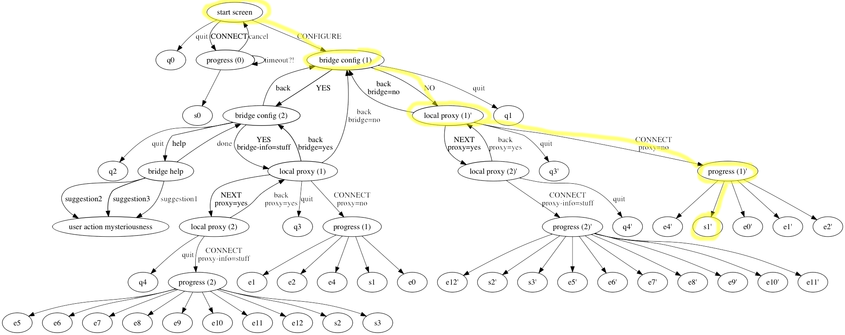
Pilot: Primal vs ___
Notes:
What we learned: tested the screen capture and survey, reduced number of tasks, got feedback on confusions, using tor’s search engine

Slide 25
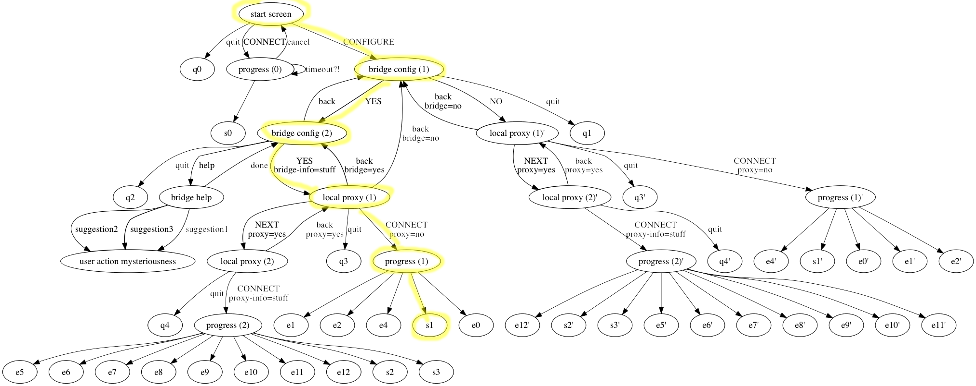
Pilot: Arjun vs ______
Notes:
What we learned: how people might look for help if they can’t configure, issues with slow relays, parallelization of tasks, idea for blocking hardcoded, both success on first try (not realistic?).

Slide 26
Limitations
Small-scale
Windows-only
No risk
Non-Tor users
Simulated environment
Missing stateful information sources

Slide 27
Discussion
What are reasonable user assumptions?
What is the right balance between transparency and automation?
What are the ethical considerations of an alternate, automated interface?

